Slide 1
Willowmoor Project Period
County Ends Maintenance
“Modified Existing Condition” Baseline Period (2014-17)
30 Year Peak Flooding Levels under 27.5’
Minimum Lake Level Target 25.4’
Source: https://nwis.waterdata.usgs.gov/nwis/monthly?search_site_no=12122000&format=sites_selection_links

Slide 2
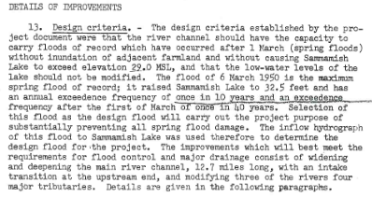

Slide 3
